Slide 1
Axis Insurance Customer Data Analysis
David Stoneking - Analyst

Slide 2
Agenda
Data Breakdown
Data Analysis - Univariate
Data Analysis – Bivariate & Multi Variate
Customer Profiles
Customer Segmentation
Do Smokers Incur More Medical Charges?
Do Males and Females Have Different BMI Values?
Is the Proportion of Smokers More/Less Across Different Regions?
Is there a Correlation between Number of Children and Mothers’ BMI?
Conclusions
Recommendations

Slide 3
Data Breakdown
The data Primary and contains information on insurance customers
Note:
There are no missing values in the dataset
The Qualitative data in the columns Sex, Smoker and Region were converted from Objects to Categories
Age, BMI, Children and Charges are Quantitative
Age and Children are of Discrete type
BMI and Charges are of Continuous type
* Data excludes 65 years and older

Slide 4
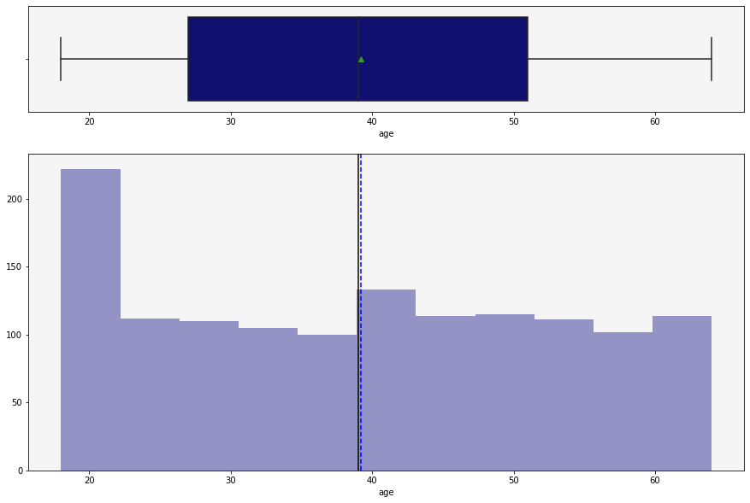
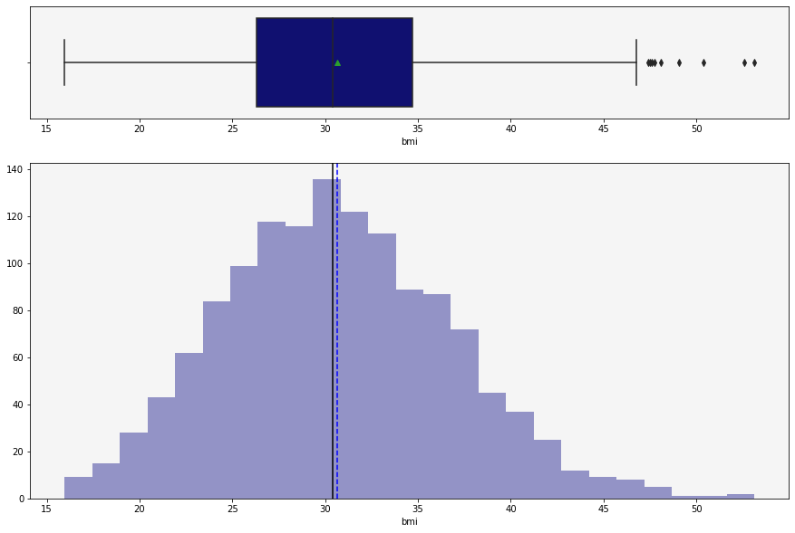
Data Analysis – Age, BMI
Age
BMI
The distribution is not skewed
The mean is approximately 38 years old
The distribution is right skewed
The mean BMI is approximately 31 kg/m²
There are outliers, with some customers exceeding values of 45 kg/m²

Slide 5
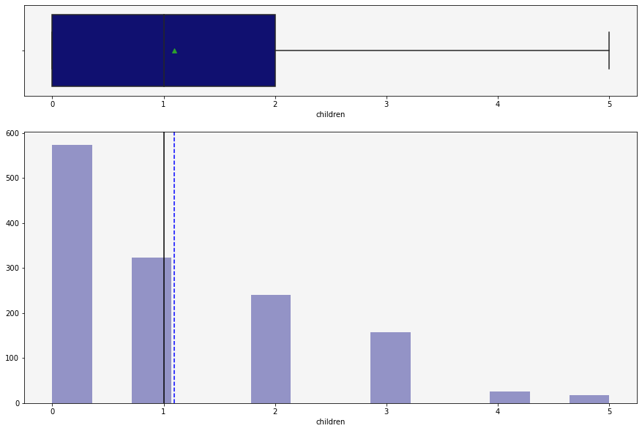
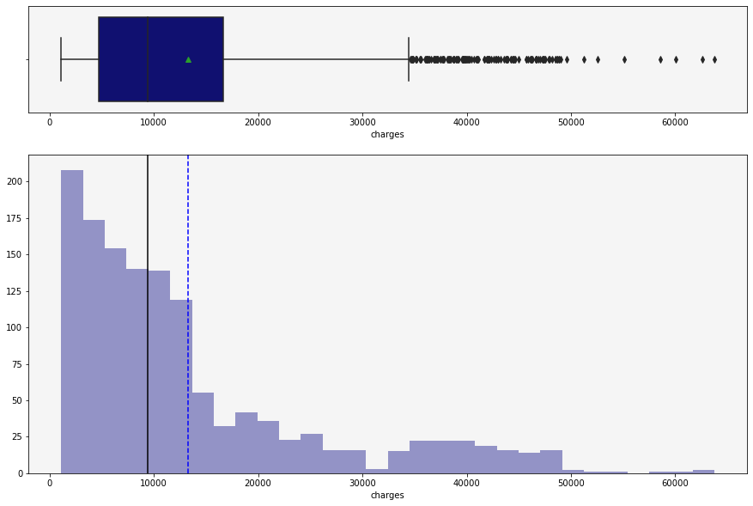
Data Analysis – Children Charges
Number of Children
Medical Charges
The distribution is right skewed
The mean is between 1 and 2 children
The distribution is right skewed
It contains a large number of outliers - 35,000 and above

Slide 6
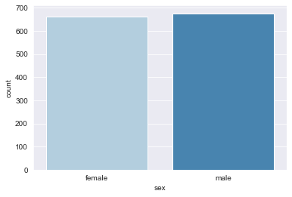
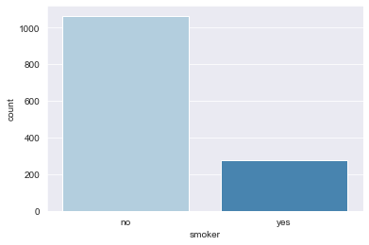
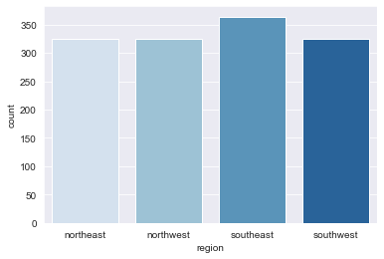
Data Analysis – Sex, Smoker, Region
Number of Females/Males
Number of Smokers
Number From Each Region
There are more male customers than female
There are over 600 in each category
There are many more non-smokers than smokers
There are over 1,000 non-smokers and less than 300 smokers
There are more customers in the southeast than the other regions – over 350
The other three regions are approximately even in count ~ 320

Slide 7
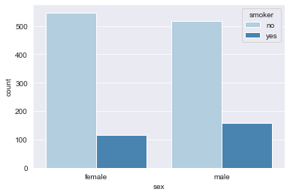
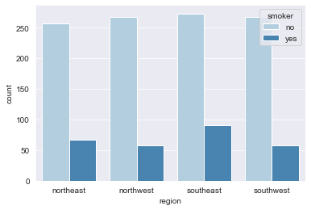
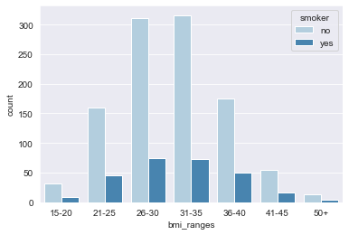
Data Analysis – Sex, Region, BMI vs. Smokers
Count – Sex vs. Smoker Status
Count – Region vs. Smoker Status
Count – BMI vs. Smokers Status
There are more male smokers than female smokers
There are more non-smoking females than males
There are approximately five times the number of non-smokers vs smokers
The representation of customers from each region is close to even
The southeast produced more smokers
The average region has approximately 250 non-smokers and around 50 smokers
The distribution of BMI ranges follows the same normal-right skewed distribution as seen previously in the general population histogram

Slide 8
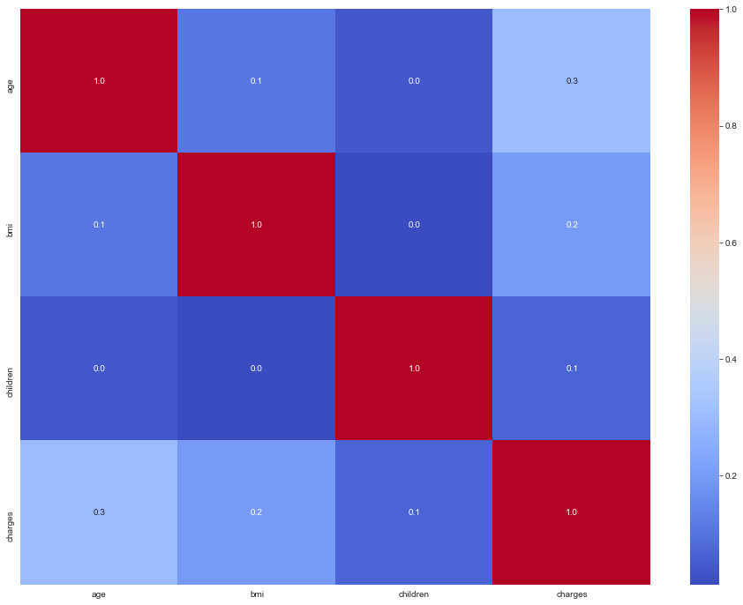
Correlation Matrix
There is a small correlation between age and medical charges
This matrix is lacking in any meaningful correlation – further investigation is required
We need to compare the numerical data with the categorical data to pull meaningful insight from the dataset

Slide 9
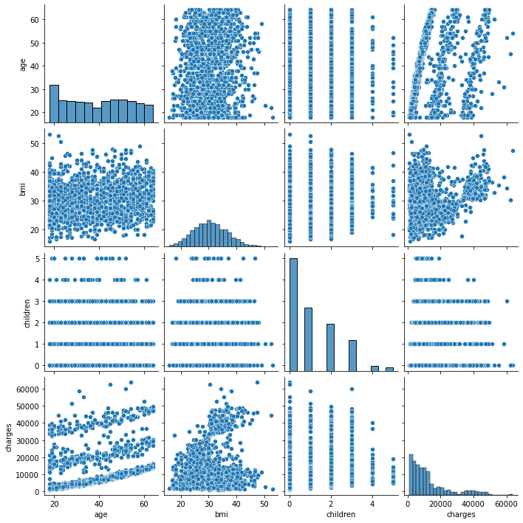
Pairplot
There is a jump in charges for BMI values above 30, however there are also low charges as well. This will require further analysis to identify the driver
There is a positive trend with age and charges. This will require further analysis, as there appears to be three separate trend-lines
The remaining plots offer little-to-no insight into any trends
More thorough analysis is needed

Slide 10
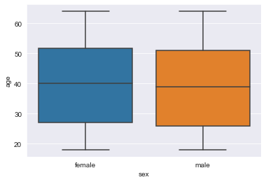
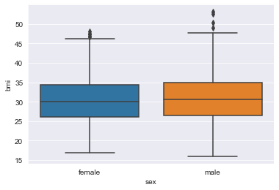
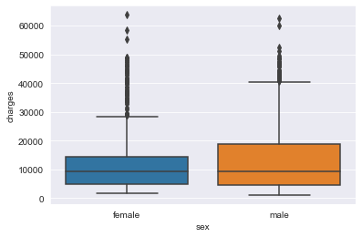
Data Analysis – Sex with Age, BMI and Charges
Sex vs. Age
Sex vs. BMI
Sex vs. Charges
The females in the dataset tend to be a bit older than the males
The distribution of BMI among the male vs. female dataset is fairly close – Slightly higher for males
Will require further investigation to see if there is a difference, male vs female
On average, males incur more charges compared to women, although the median is about the same

Slide 11
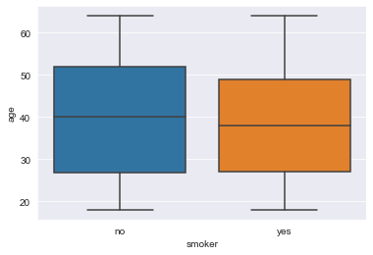
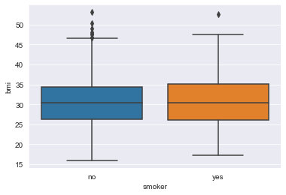
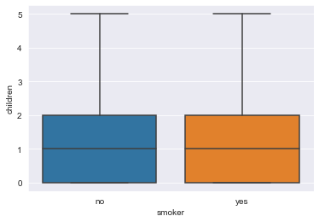
Data Analysis – Smoker Status with Age, BMI and Children
Smoker Status vs. Age
Smoker Status vs. BMI
Smoker Status vs. Charges
There tend to be less smokers as customers get older
Smokers have a bit higher tendency for higher BMI values
The number of children appears to be independent of smoking status

Slide 12
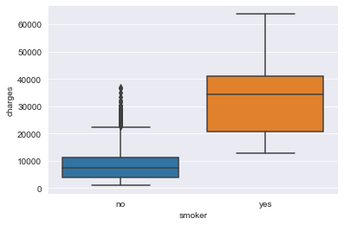
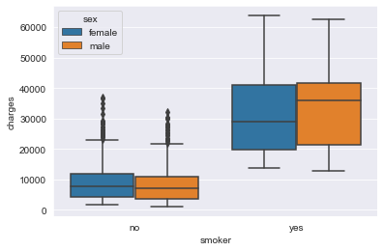
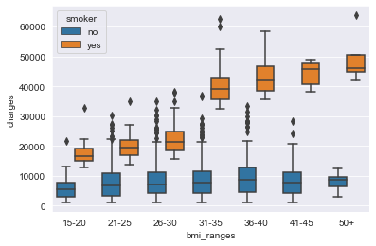
Data Analysis – Smoker Status vs. Charges
Smoker Status vs. Charges
Smoker Status vs. Charges & Sex
BMI Range vs. Charges & Smoker Status
It initially appears to be a strong correlation for Smokers having more charges
This will be our Alternate Hypothesis in further testing
Splitting Smokers between male & female shows a strong positive correlation with smoking and charges, independent of sex
Dividing the customers into different ranges of BMI values, shows a jump in charges when BMI gets above 30 for smokers
There are increased costs for non-smokers as BMI goes up, but relatively low

Slide 13
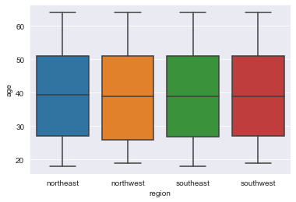
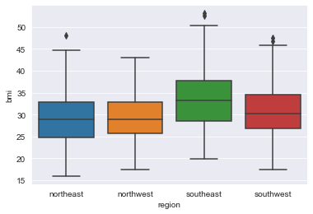
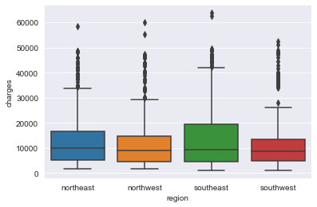
Data Analysis – By Region
Region vs. Age
Region vs. BMI
Region vs. Charges
The spread on Age is very close in all regions
Higher values for BMI in the southeast and southwest
Charges are higher in the southeast
Southwest has the lowest spread of charges

Slide 14
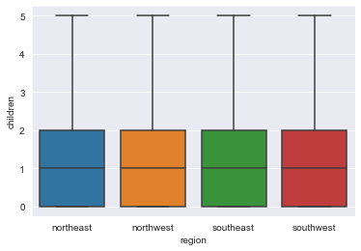


Data Analysis – By Number of Children
Region vs. Number of Children
Sex vs. Number of Children
Region vs. Charges
The spread on Age is very close in all regions
The Number of children are the same for each gender of customer
Smokers and Non-Smokers have the same number of children comparitively

Slide 15
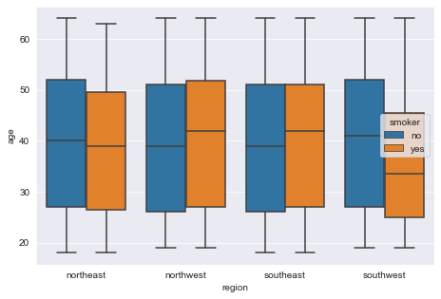
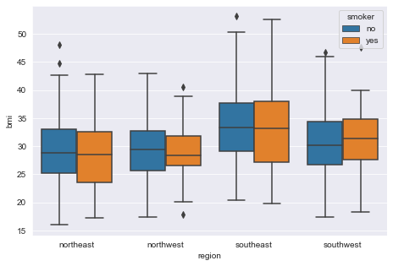
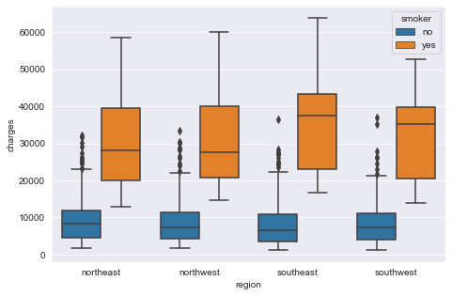
Data Analysis – By Region
Region vs. Age & Smoker Status
Region vs. BMI & Smoker Status
Region vs. Charges & Smoker Status
Nearly even distribution in the northwest and southeast
Slightly younger group of smokers in the northeast and a bit younger in the southwest
Higher values for BMI in the southeast and southwest
BMI values trend with the particular region and about the same between smokers and non-smokers
Charges are relatively the same across the regions for non-smokers
Large jump in charges for smokers across the board
Even a bit more so for smokers in the southeast

Slide 16
Customer Profiles
SMOKERS
Have much higher rates of medical charges than non-smokers
They live in all regions of the U.S.
They tend to have the same number of children as non-smokers
Medical charges increase sharply for BMI ranges above 30
NON-SMOKERS
Rates of medical charges are much lower than smokers
Rates of medical charges remain low as they age
They have higher bmi rates in the southeast compared to their counterparts in the north regions
BMI values trend upwards as they age
Regional / General
Older people tend to put on more weight
As people age and put on weight, they generally incur more charges
They have higher bmi rates in the southeast compared to their counterparts in the north regions

Slide 17
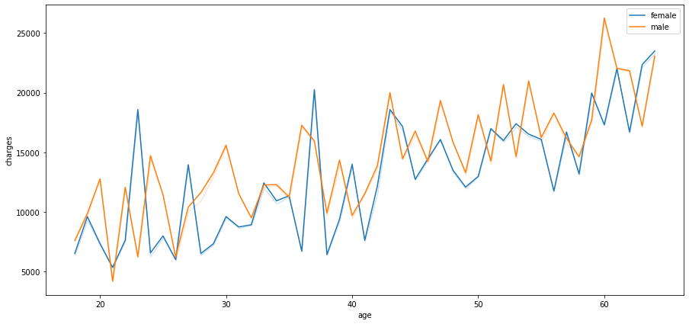
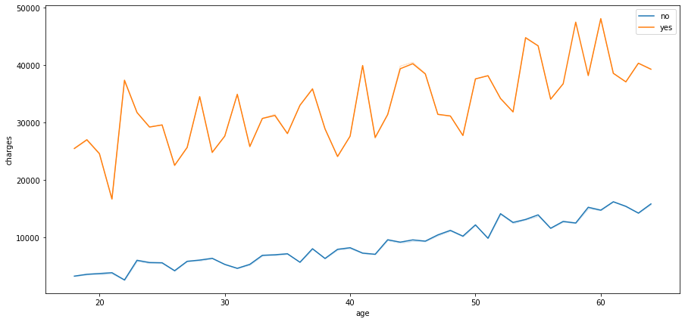
Customer Segmentation
Age vs. Charges & Gender
Age vs. Charges & Smoker Status
Charges trend up as people age
Charges accelerate after age 40
Charges trend the same regardless of gender
Smokers have much higher medical charges – over 2 times
Non-Smoker charges stay under 20,000 for 60 year olds while smokers are around 40,000

Slide 18
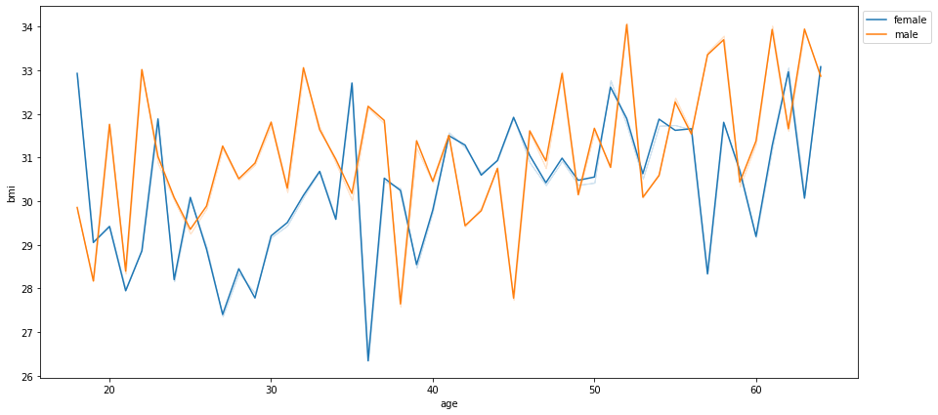
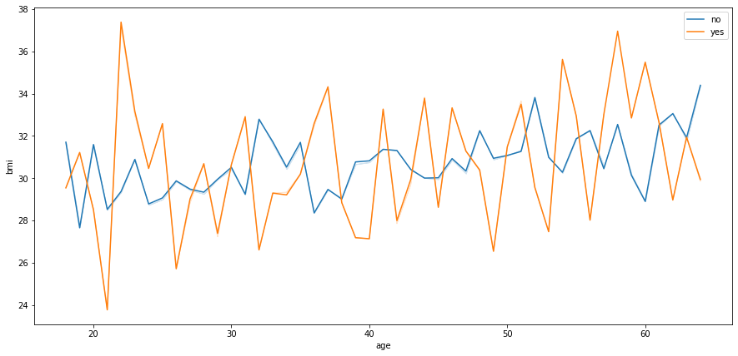
Customer Segmentation
Age vs. BMI & Gender
Age vs. BMI & Smoker Status
BMI generally trends up with age
People tend to reduce BMI during 35-45 year range
BMI for females is generally slightly lower than males
Smokers have higher BMI swings while non-smokers are more stable
BMI trends up slightly with age for both smokers and non-smokers

Slide 19
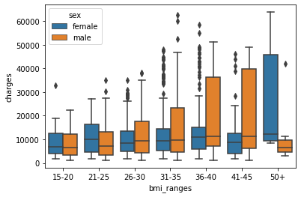
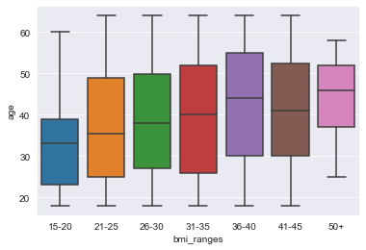
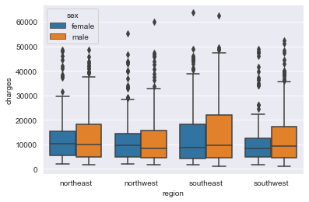
Customer Segmentation
BMI vs. Charges & Sex
BMI vs Age
Region vs. Charges
Charges generally trend up with BMI for Males
Charges stay flat for females and then spike when BMI hits 50+
People generally put on weight as they get older
As previously noted, this corresponds to increased medical charges
Men generally have higher Charges than Women – independent of Region
The medical costs are closest in the Northwest, between the sexes

Slide 20

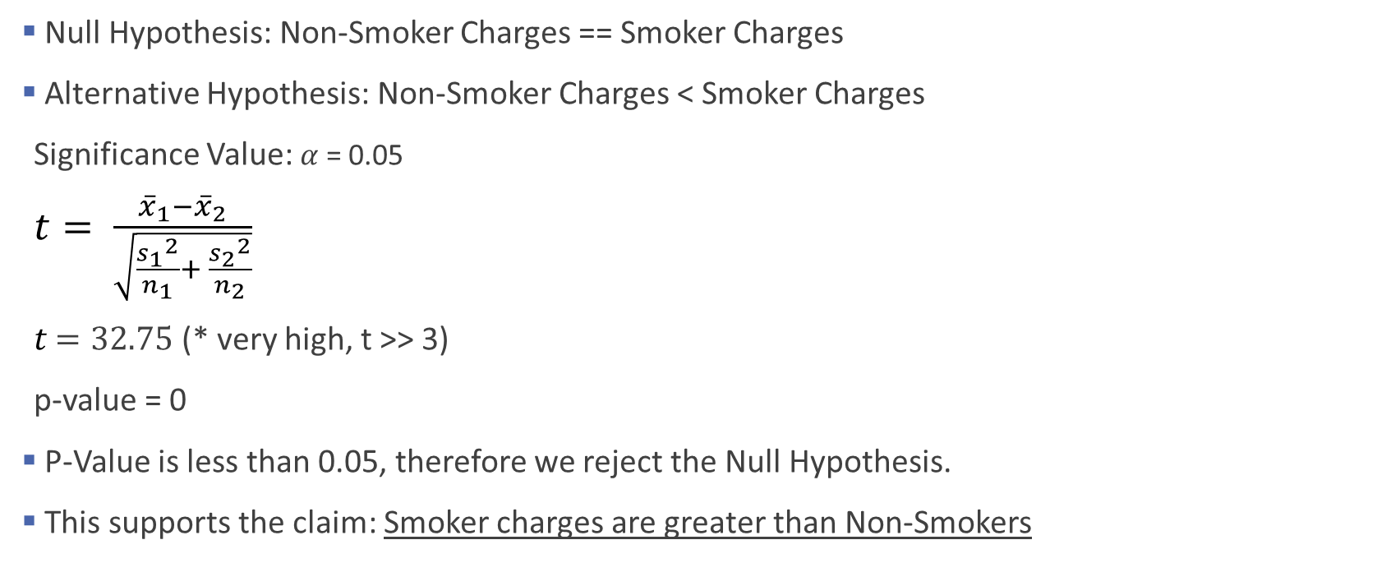
Do Smokers Incur More Medical Charges? - T Test
Null Hypothesis: Non-Smoker Charges == Smoker Charges
Alternative Hypothesis: Non-Smoker Charges < Smoker Charges
Significance Value: $α$= 0.05
$t= \frac{{\overline{x}}_{1}−{\overline{x}}_{2}}{\sqrt{\frac{{s_{1}}^{2}}{n_{1}}+ \frac{{s_{2}}^{2}}{n_{2}}}}$
$t$ $=32.75$ (* very high, t >> 3)
p-value = 0
P-Value is less than 0.05, therefore we reject the Null Hypothesis.
This supports the claim: Smoker charges are greater than Non-Smokers

Slide 21

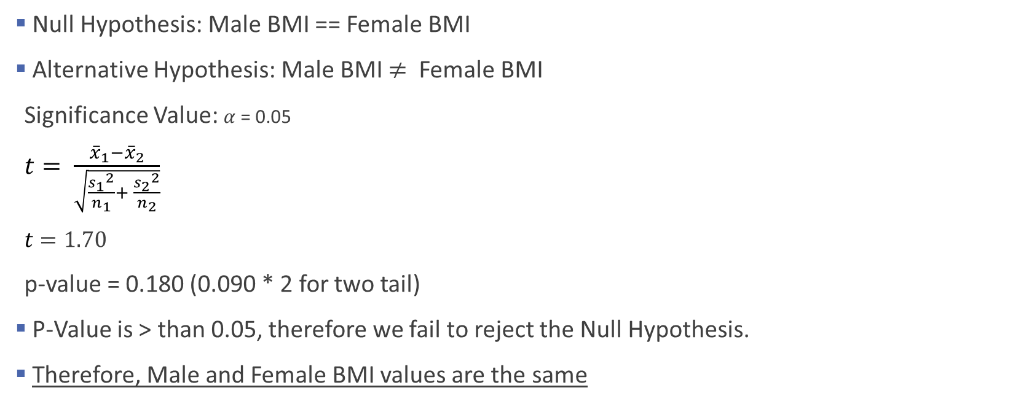
Do Males and Females Have Different BMI Values?
Null Hypothesis: Male BMI == Female BMI
Alternative Hypothesis: Male BMI $≠$ Female BMI
Significance Value: $α$= 0.05
$t= \frac{{\overline{x}}_{1}−{\overline{x}}_{2}}{\sqrt{\frac{{s_{1}}^{2}}{n_{1}}+ \frac{{s_{2}}^{2}}{n_{2}}}}$
$t$ $=1.70$
p-value = 0.180 (0.090 * 2 for two tail)
P-Value is > than 0.05, therefore we fail to reject the Null Hypothesis.
Therefore, Male and Female BMI values are the same
verified with stats.ttest_ind()

Slide 22

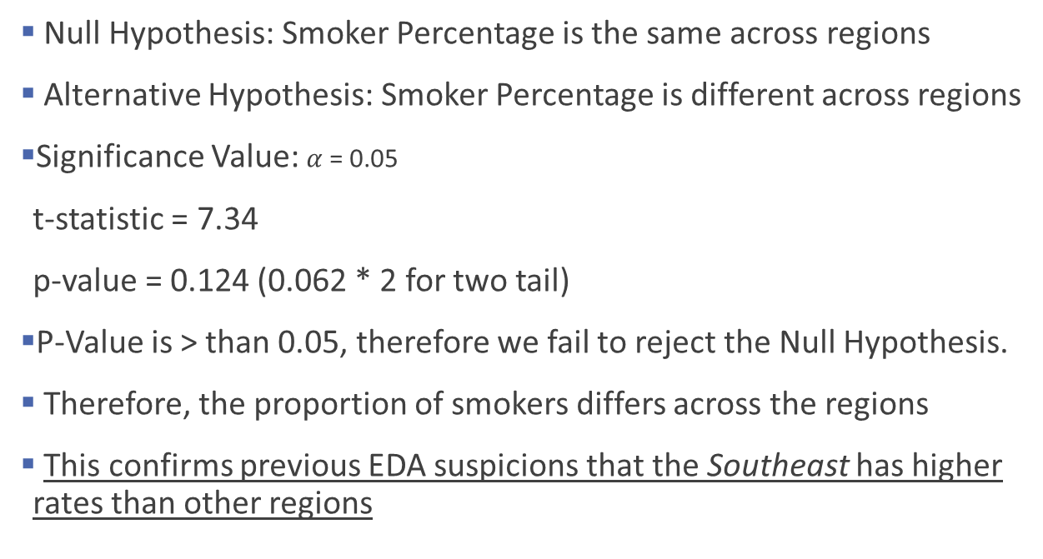
Is the proportion of Smokers More/Less Across Regions?
Null Hypothesis: Smoker Percentage is the same across regions
Alternative Hypothesis: Smoker Percentage is different across regions
Significance Value: $α$= 0.05
t-statistic = 7.34
p-value = 0.124 (0.062 * 2 for two tail)
P-Value is > than 0.05, therefore we fail to reject the Null Hypothesis.
Therefore, the proportion of smokers differs across the regions
This confirms previous EDA suspicions that the Southeast has higher rates than other regions

Slide 23
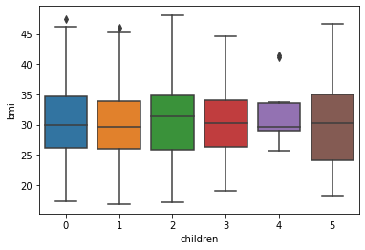
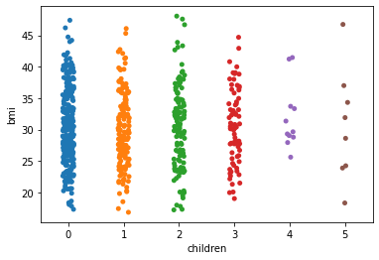
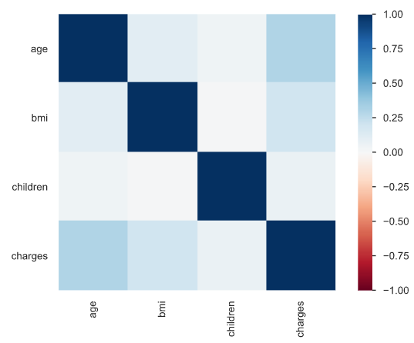
Is There a Correlation between Number of Children and Mothers’ BMI?
Initial EDA shows little-to-no correlation between children and BMI
Checking the mean BMI shows approximately the same ~30 BMI
There is No correlation between number of children and bmi

Slide 24
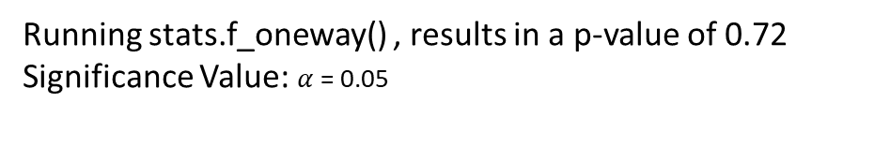
Is There a Correlation between Number of Children and Mothers’ BMI? – Cont.
Null Hypothesis: The BMI is the same for Women regardless of number of children
Alternative Hypothesis: The BMI differs for Women depending on number of children
The mean values for each sample population are the same
In this case, we fail to reject the Null Hypothesis and confirm the mean BMI is the same
Also, the p-value is 0.72 and greater than 0.05, which confirms failure to reject Null Hypothesis
Running stats.f_oneway() , results in a p-value of 0.72
Significance Value: $α$= 0.05

Slide 25
Conclusions
As people gain weight (higher BMI), they will accumulate more medical charges
It is generally more healthier and cheaper to maintain a moderate BMI level
As people age, they tend to accumulate more medical charges
They also accumulate weight which exacerbates the rise in medical chargess
Smokers are at the greatest risk for medical charges, compared to non-smokers
Older people who smoke and are overweight have the highest risk for health issues
BMI for females is the same as males
The Southeast has higher proportions of smokers than other regions
The BMI of women is relatively the same irrespective of the number of children they have

Slide 26
Recommendations
Encourage customers with insurance discounts if:
They can maintain lower BMI values
Refrain from smoking
Provide multiple and Tiered Discounts for BMI Ranges, increasing discount as BMI goes down
Encourage customers to purchase more medical insurance as they age, to offset increased medical bills
Provide customers with insurance discounts for Not Smoking or Quitting Smoking
This should be even greater than the BMI discounts, since smoking drives medical costs even more so
In other words, overweight smokers should spend the most for their insurance due to the corresponding health risks
Focus on providing customers with education on eating healthy and exercising, especially in the Southern Regions

Slide 27
Q&A

Slide 28
Backup Slides

